Slide 1




TEAM KDB | 2026
INNOVATION FAIR
KDB ASSISTANT

Slide 2


THE CHALLENGE IN ACADEMIC SUPPORT
WHAT PROBLEM ARE WE SOLVING?
KEY CHALLENGES IN UNIVERSITY EDUCATION
Manual grading is time-consuming and difficult to scale across large courses. Feedback quality varies significantly with instructor workload and time pressure. Students need academic help outside office hours when support is unavailable. Generic AI tools lack alignment with specific course content and learning objectives.

Slide 3


PRODUCT OVERVIEW
WHAT IS KDB ASSISTANT?
COURSE-AWARE AI PLATFORM
A Moodle-based AI platform that uses uploaded course materials as source context. Designed for both students and professors, it supports personalized learning and controlled, rubric-based feedback.
Built around academic integrity and course alignment, KDB Assistant delivers intelligent support that respects institutional standards while enhancing the learning experience.

Slide 4

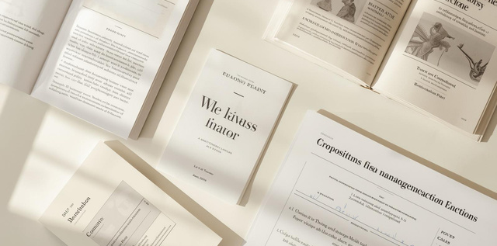

AI-POWERED LEARNING TOOLS
STUDENT LEARNING FEATURES
Course-Aware AI Chatbot: Answers questions grounded in lecture notes, slides, and PDFs. Provides relevant academic support tied directly to your course materials, ensuring accurate and contextual responses.
PERSONALIZED TOPIC EXPLANATION
Practice Exam Generator: Creates practice exams directly from course content. Supports targeted revision and exam preparation with questions aligned to learning objectives.
Tailors explanations based on student's weak areas. Helps improve understanding where needed most.

Slide 5


ASSESSMENT TOOLS
PROFESSOR AND ASSESSMENT FEATURES
KDB Assistant provides professors with powerful AI-driven assessment capabilities. The AI Rubric Engine evaluates student submissions using professor-defined criteria, leveraging marking instructions, expected structure, and learning outcomes for accurate, consistent grading.
STRUCTURED AI FEEDBACK
Generates detailed analysis highlighting strengths, weaknesses, and specific improvement points. Supports draft review workflows and maintains evaluation consistency across submissions.
Note: More detailed rubric input from professors strengthens alignment with grading expectations.

Slide 6


FEEDBACK MODES
FLEXIBLE FEEDBACK MODES
ADAPTING TO TEACHING STRATEGIES
Three configurable feedback modes allow professors to tailor AI assistance to their teaching strategy—from rich, detailed guidance that supports intensive learning, to minimal feedback that ensures strict academic integrity and independent work.

Slide 7


TECHNICAL OVERVIEW
HOW THE SYSTEM WORKS
INTEGRATED ARCHITECTURE
The system combines course materials, AI assistance, and rubric-based evaluation into a unified workflow. Self-hosted AI architecture ensures data privacy and academic control.
Key components include Moodle integration, course materials repository, course-aware chatbot, practice exam generator, AI rubric engine, and feedback mode controller—all working together seamlessly.
LEARN MORE:
KDBASSISTANT.EDU

Slide 8


COURSE-AWARE ACADEMIC AI
THANK YOU
SMARTER LEARNING • TARGETED PREPARATION • STRUCTURED AI FEEDBACK

